Slide 1
Deep Learning (CS324)
11. Beyond vectors: DL on graphs*
Jianguo Zhang
SUSTech
*This lecture is mostly based on this article and the references at the end of the slides
Kipf & Welling (ICLR 2017), Semi-Supervised Classification with Graph Convolutional Networks
Notes:
Please read this post first, before reading the mentioned post in the slides.
How to do Deep Learning on Graphs with Graph Convolutional Networks
https://towardsdatascience.com/how-to-do-deep-learning-on-graphs-with-graph-convolutional-networks-7d2250723780

Slide 2
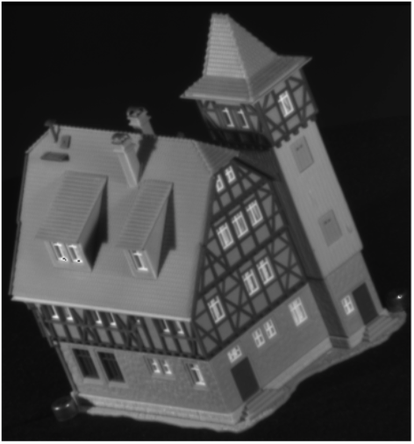
Features vs Structure
Object as set of extracted features
Object as components in relation with each other

Slide 3
Features vs Structure
Object as set of extracted features
Object as components in relation with each other
[f1, f2, f3, ... , fn]

Slide 4
Features vs Structure
Object as set of extracted features
Object as components in relation with each other

Slide 5
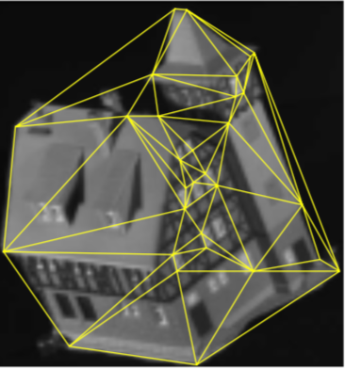
Features vs Structure
Object as set of extracted features
Object as components in relation with each other

Slide 6
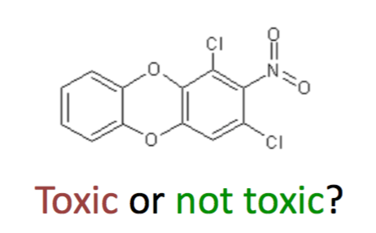
Features vs Structure
Object as set of extracted features
Object as components in relation with each other

Slide 7
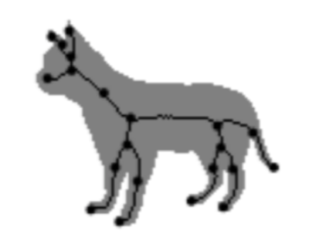
Features vs Structure
Object as set of extracted features
Object as components in relation with each other

Slide 8
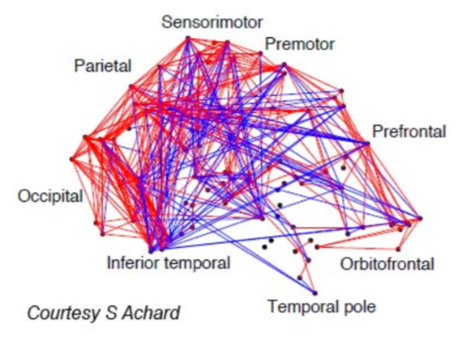
Features vs Structure
Object as set of extracted features
Object as components in relation with each other

Slide 9
Graphs
A graph consists of

Slide 10
Graphs
A graph consists of
A set of vertices V (e.g., parts of an object)

Slide 11
Graphs
A graph consists of
A set of vertices V (e.g., parts of an object)
A set of edges E (e.g., relations between parts)

Slide 12
Graphs
A graph consists of
A set of vertices V (e.g., parts of an object)
A set of edges E (e.g., relations between parts)
Vertices can be labelled

Slide 13
Graphs
A graph consists of
A set of vertices V (e.g., parts of an object)
A set of edges E (e.g., relations between parts)
Edges can be directed

Slide 14
Graphs
A graph consists of
A set of vertices V (e.g., parts of an object)
A set of edges E (e.g., relations between parts)
Edges can be weighted

Slide 15
Graphs
A graph consists of
A set of vertices V (e.g., parts of an object)
A set of edges E (e.g., relations between parts)

Slide 16
Graphs
A graph consists of
A set of vertices V (e.g., parts of an object)
A set of edges E (e.g., relations between parts)
1
2
3
4

Slide 17
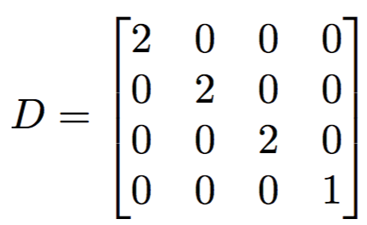
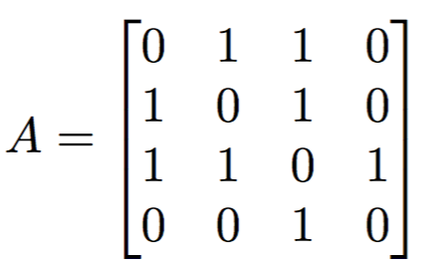
Graphs
A graph consists of
A set of vertices V (e.g., parts of an object)
A set of edges E (e.g., relations between parts)
1
2
3
Degree matrix
4
Adjacency matrix
Notes:
Check Wikipedia about the definition of the degree of a node in a Graph. https://en.wikipedia.org/wiki/Degree_matrix: In an undirected graph, this means that each loop increases the degree of a vertex by two. In a directed graph, the term degree may refer either to indegree (the number of incoming edges at each vertex) or outdegree (the number of outgoing edges at each vertex).
In the mathematical field of graph theory, the degree matrix is a diagonal matrix which contains information about the degree of each vertex—that is, the number of edges attached to each vertex.^{[1]} It is used together with the adjacency matrix to construct the Laplacian matrix of a graph.^{[2]}

Slide 18

Graphs
A graph consists of
A set of vertices V (e.g., parts of an object)
A set of edges E (e.g., relations between parts)
1
2
3
Degree matrix
4
Adjacency matrix
Laplacian matrix

Slide 19
Learning on graphs
How to apply deep learning (or even just standard machine learning) to graph data?
You have a dataset of graphs representing chemical compounds, with label toxic/not-toxic. How to train an algorithm to distinguish them?

Slide 20
Learning on graphs
How to apply deep learning (or even just standard machine learning) to graph data?
You have a dataset of graphs representing chemical compounds, with label toxic/not-toxic. How to train an algorithm to distinguish them?
ML/DL algorithms work on vectorial spaces

Slide 21
Learning on graphs
How to apply deep learning (or even just standard machine learning) to graph data?
You have a dataset of graphs representing chemical compounds, with label toxic/not-toxic. How to train an algorithm to distinguish them?
ML/DL algorithms work on vectorial spaces
i.e., the input is a matrix of data points

Slide 22
Learning on graphs
How to apply deep learning (or even just standard machine learning) to graph data?
You have a dataset of graphs representing chemical compounds, with label toxic/not-toxic. How to train an algorithm to distinguish them?
ML/DL algorithms work on vectorial spaces
i.e., the input is a matrix of data points

Slide 23
Learning on graphs
How to apply deep learning (or even just standard machine learning) to graph data?
You have a dataset of graphs representing chemical compounds, with label toxic/not-toxic. How to train an algorithm to distinguish them?
ML/DL algorithms work on vectorial spaces
i.e., the input is a matrix of data points
?

Slide 24
Learning on graphs
How to apply deep learning (or even just standard machine learning) to graph data?
You have a dataset of graphs representing chemical compounds, with label toxic/not-toxic. How to train an algorithm to distinguish them?
ML/DL algorithms work on vectorial spaces
i.e., the input is a matrix of data points
… [-2, 0, 0, 1.2, …] [0, 1, -2, 0.5, …] [-1.2, 1, 0, 0, …]
…
?

Slide 25
Learning on graphs
Turning a graph into a vector (i.e., embedding a graph into a vectorial space) it’s not an easy task
What’s the right order of the nodes? If I change the order I change the point in the embedding space, e.g., [1 0 2] is different from [2 1 0]
Graphs describing objects from the same class can vary in size, so the dimension of the corresponding vectors would change as well. How do I compare [1 0 2] to [1 0 1 1]?

Slide 26
Learning on graphs
Luckily researchers in the field of machine learning and deep learning have come up with a variety of ways to apply machine/deep learning to graph by either computing the embedding directly, or indirectly
In this lecture, we only focus on how CNNs can be generalised to work on graphs

Slide 27
Learning on graphs
Luckily researchers in the field of machine learning and deep learning have come up with a variety of ways to apply machine/deep learning to graph by either computing the embedding directly, or indirectly
In this lecture, we only focus on how CNNs can be generalised to work on graphs
Note: is a very new and rapidly evolving field, my intention is just to offer you a glimpse of it

Slide 28
Learning on graphs
The type of tasks we’re interested in solving when dealing with graphs are typically:
Graph classification
Just like what you’re used to, but instead of assigning a label to a point you assign it to a graph

Slide 29
Learning on graphs
The type of tasks we’re interested in solving when dealing with graphs are typically:
Node classification
You assume some nodes have labels (e.g., age, sex, income, etc.) other don’t, and you want to find out the missing information
£10k
£18k
£31k
?
?
£20k
£15k
£28k

Slide 30
Learning on graphs
The type of tasks we’re interested in solving when dealing with graphs are typically:
Link prediction
Some links in your graphs are missing and your task is to find what they are
£10k
£18k
£31k
£29k
£11k
£20k
£15k
£28k

Slide 31
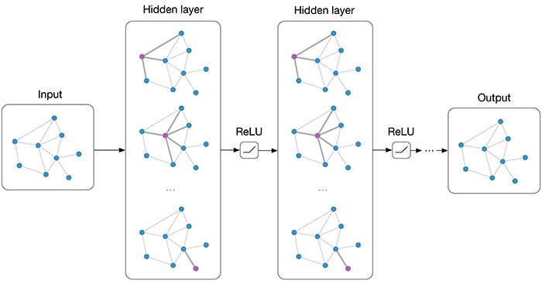
Graph Convolutional Networks
Source: https://tkipf.github.io/graph-convolutional-networks/

Slide 32
Graph Convolutional Networks
Assume each node i of the graph G with adjacency matrix A has an associated feature xi
The input of the GCN is the matrix of node features X and the adjacency matrix A
The output is either a matrix Z associating a scalar/vector to each node of G or combine them in some way* to obtain a single label for G
*See for example this paper

Slide 33
Graph Convolutional Networks
Assume each node i of the graph G with adjacency matrix A has an associated feature xi
The input of the GCN is the matrix of node features X and the adjacency matrix A
The output is either a matrix Z associating a scalar/vector to each node of G or combine them in some way* to obtain a single label for G

Slide 34

Graph Convolutional Networks
The layers of the network transform their input according to a non-linear transformation

Slide 35
Graph Convolutional Networks
The layers of the network transform their input according to a non-linear transformation
H⁽⁰⁾ is the feature matrix X

Slide 36
Graph Convolutional Networks
The layers of the network transform their input according to a non-linear transformation
H^{(L)} is the output matrix Z (the last layer)

Slide 37
Graph Convolutional Networks
The layers of the network transform their input according to a non-linear transformation
Different GCN models vary in the choice and parametrisation of f

Slide 38

GCN: a simple example
A simple network could be defined as follows

Slide 39
GCN: a simple example
A simple network could be defined as follows
Parameters of the l-th layer

Slide 40
GCN: a simple example
A simple network could be defined as follows
What’s happening here? Remember, for l=0 that’s a multiplication between the adjacency matrix and the node-feature matrix

Slide 41
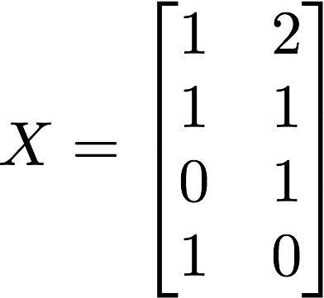
GCN: a simple example
A simple network could be defined as follows
What’s happening here? Remember, for l=0 that’s a multiplication between the adjacency matrix and the node-feature matrix
[1,2]
[1,1]
[0,1]
[1,0]

Slide 42
GCN: a simple example
A simple network could be defined as follows
Multiplying A and H computes a new feature for the node i which is the
sum of all the features of its neighbours
[1,2]
[1,1]
[0,1]
[1,0]

Slide 43
GCN: a simple example
A simple network could be defined as follows
Multiplying A and H computes a new feature for the node i which is the
sum of all the features of its neighbours
[1,2]
[1,1]
[0,1]
[1,0]

Slide 44
GCN: a simple example
A simple network could be defined as follows
So at each layer for each node we compute a new feature vector which is
a non-linear function of its neighbours’ features, and so on. The features are propagated.
[1,2]
[1,1]
[0,1]
[1,0]

Slide 45
GCN: a simple example
A simple network could be defined as follows
The problems of the above formulation:
The feature at node i is NOT included in the computation of the new aggregated feature at node i.
[1,2]
[1,1]
[0,1]
[1,0]

Slide 46
GCN: a simple example
A simple network could be defined as follows
The problem of the above formulation:
Different node has different degrees, i.e, has different number of edges; node with large degrees might have large representations, and vice versa. This might cause explosion or vanishing problem.
[1,2]
[1,1]
[0,1]
[1,0]

Slide 47
GCN: a simple example
A simple network could be defined as follows
We modify this in two ways:
Add a loop to each node, so the old feature is included in the computation of the new feature
[1,2]
[1,1]
[0,1]
[1,0]

Slide 48

GCN: a simple example
A simple network could be defined as follows
We modify this in two ways:
Normalise A so the scale of the feature vectors doesn’t change, i.e.,
[1,2]
[1,1]
$$H^{\left(l+1\right)}=\operatorname{Re}{LU\left({\hat{D}}^{−1}\hat{A}H^{l}W^{l}\right)}$$
[0,1]
[1,0]

Slide 49
GCN: a simple example
A simple network could be defined as follows
We modify this:
Normalise A so the scale of the feature vectors doesn’t change.
When computing the aggregate feature representation of the ith node, we not only take into consideration the degree of the ith node, but also the degree of the jth node. We could have the following formula
$$H^{\left(l+1\right)}=\operatorname{Re}{LU\left({\hat{D}}^{−1}\hat{A}H^{l}W^{l}\right)}$$
Source: https://towardsdatascience.com/how-to-do-deep-learning-on-graphs-with-graph-convolutional-networks-62acf5b143d0
Source: https://arxiv.org/pdf/1609.02907.pdf

Slide 51
Graph Convolutional Networks Receptive Field and Feature Depth
Source: https://tkipf.github.io/graph-convolutional-networks/

Slide 52
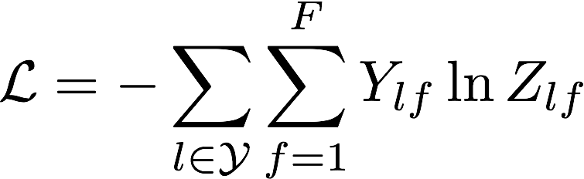
GCN for node classification
We can add a softmax layer at the end and apply the GCN to predict the labels of the nodes of a graph, where some of the nodes already have labels (training set)
If we add a cross-entropy loss function we get the 2-layers GCN of Kipf et al.

Slide 53
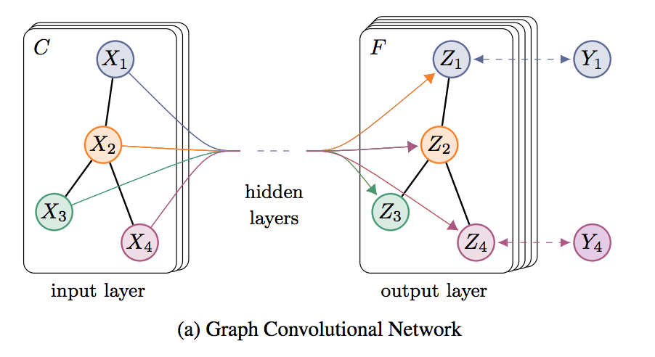
GCN for node classification
We can also explore the latent space to plot the network during the training: see this video
For an explanation of the video see Appendix A.1 and A.2 in the paper

Slide 54
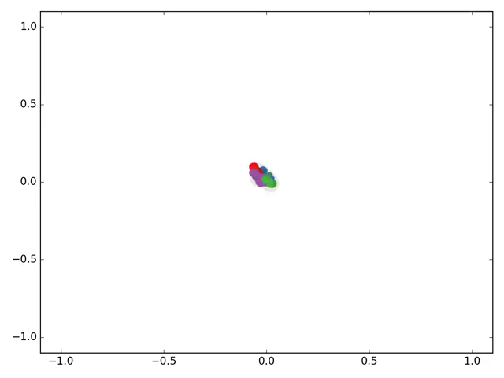
GCN for node classification
We can also explore the latent space to plot the network during the training: see this video
For an explanation of the video see Appendix A.1 and A.2 in the paper

Slide 55
GCN for graph classification
The previous architecture can be extended to deal with graph classifications (i.e., one label per graph) by combining the node-level features in a single graph-level feature
E.g., following the pooling-like approach of this paper

Slide 56
References and further reading
Duvenavud et al., NIPS 2015 http://papers.nips.cc/paper/5954-convolutional-networks-on-graphs-for-learning-molecular-fingerprints.pdf
Defferrard et al., NIPS 2016 https://arxiv.org/pdf/1606.09375.pdf
Kipf et al., ICLR 2017 https://arxiv.org/pdf/1609.02907.pdf
Gilmer et al., ICML 2017 https://arxiv.org/pdf/1704.01212.pdf

Slide 57
A very good tutorial with examples
How to do Deep Learning on Graphs with Graph Convolutional Networks
https://towardsdatascience.com/how-to-do-deep-learning-on-graphs-with-graph-convolutional-networks-7d2250723780
Strongly recommend to read and excecise.

Slide 58
Summary
Motivation of designing a deep learning model on Graphs
What are the challenges
Adjacency matrix, node features matrix, degree
Normalization of the node matrix and adding the self-loop.
Node classification and whole graph classification

Slide 59
One other area in DL not covered in this module
Deep Reinforcement learning (Deep Q-Learning)
Self-reading materials:
*A good introductory book for reinforcement learning is Reinforcement Learning: An Introduction
https://web.mst.edu/~gosavia/tutorial.pdf
V. Mnih, K. Kavukcuoglu, D. Silver, A. Graves, I. Antonoglou, D. Wierstra, M. Riedmiller, Human-level control through deep reinforcement learning, Nature 2015
: https://adeshpande3.github.io/Deep-Learning-Research-Review-Week-2-Reinforcement-Learning

Slide 60
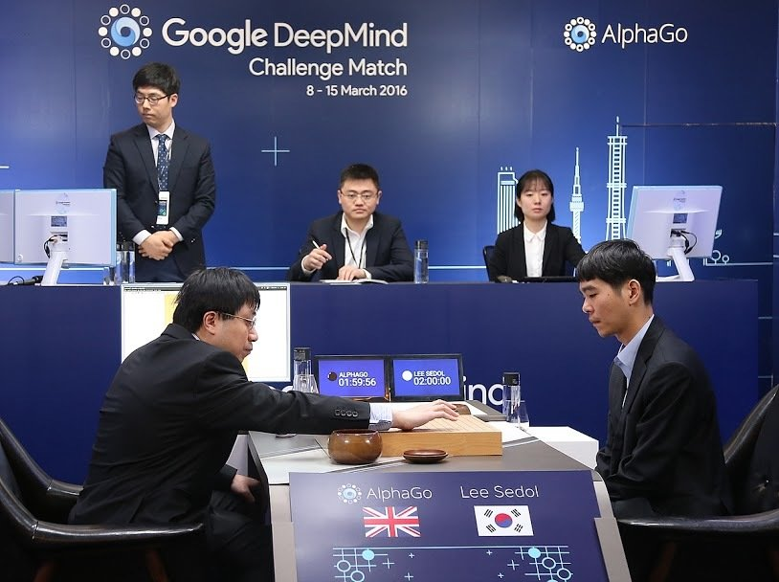
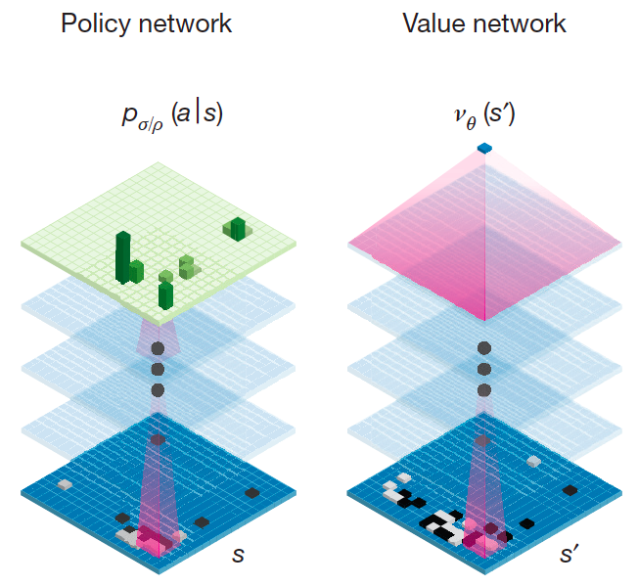
Applications of deep RL
AlphaGo and AlphaZero
https://deepmind.com/research/alphago/

Slide 61
Deep Learning
and
Learning Deeper

